Slide 1
TTEST and ANOVA
15
the theory
Probability
and
Statistics
COMS10011
Dr. Anne Roudaut
csxar@bristol.ac.uk

Slide 2
continuous independent variable
What type of data?
discrete independent variable
continuous dependent variable
discrete dependent variable
Continuous dependent variable
Discrete/categorical dependent variable
regressions
logistic
regressions
normally distributed
skewed
2 grp
>2 grp
2 grp
>2 grp
2 grp
>2 grp
Non paired
paired
Non paired
paired
Non paired
paired
Non paired
paired
Counts >= 5 in >= 75% cells
Counts >= 5 in < 75% cells
T-test
ANOVA
Mann-Whitney Utest
Wilcoxon signed rank test
Kruskall-Wallis test
Chi-square test
Fisher’s exact test
Chi-square test
Paired-t-test
Friiedman test
McNemar’s test

Slide 3
today::
look more into the math behind t-test and anova

Slide 4
lets go back to our memorization experience

Slide 5
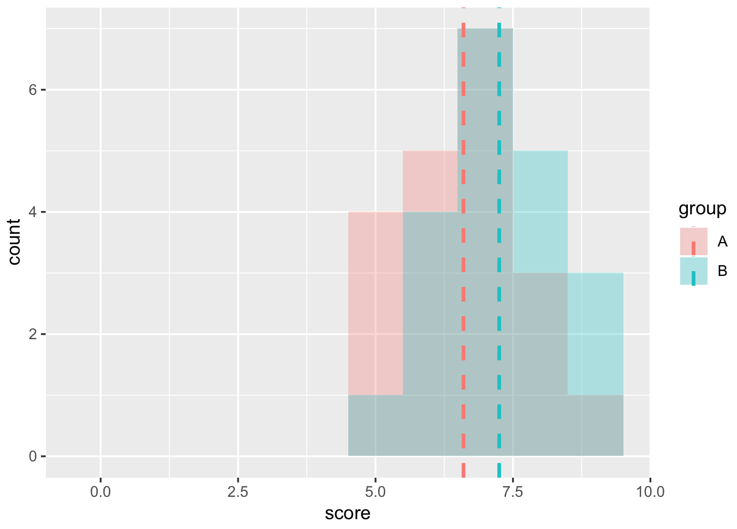
no evidences for chocolate vs. baseline (p>0.05)

Slide 6
count
memorization score
no evidences for chocolate vs. baseline (p>0.05)
(let’s just assume these are normally distributed)

Slide 7
count
probably
p<0.05
memorization score
if the mean where further apart, it would increase our chances to have a p<0.05

Slide 8
count
memorization score
<without changing the means, what else can we do to these data to make some more different?>

Slide 9
count
probably
p<0.05
memorization score
if the distributions where less spread out, it would increase our chances to have a p<0.05

Slide 10
count
signal
memorization score
noise
the goal of a study is to find
a signal in a lot of noise

Slide 11
any statistical tests ::
signal
noise

Slide 12
signal
T-tests ::
noise
difference between group means
variability of groups

Slide 13
signal
noise
T-tests ::
difference between group means
variability of groups

Slide 14
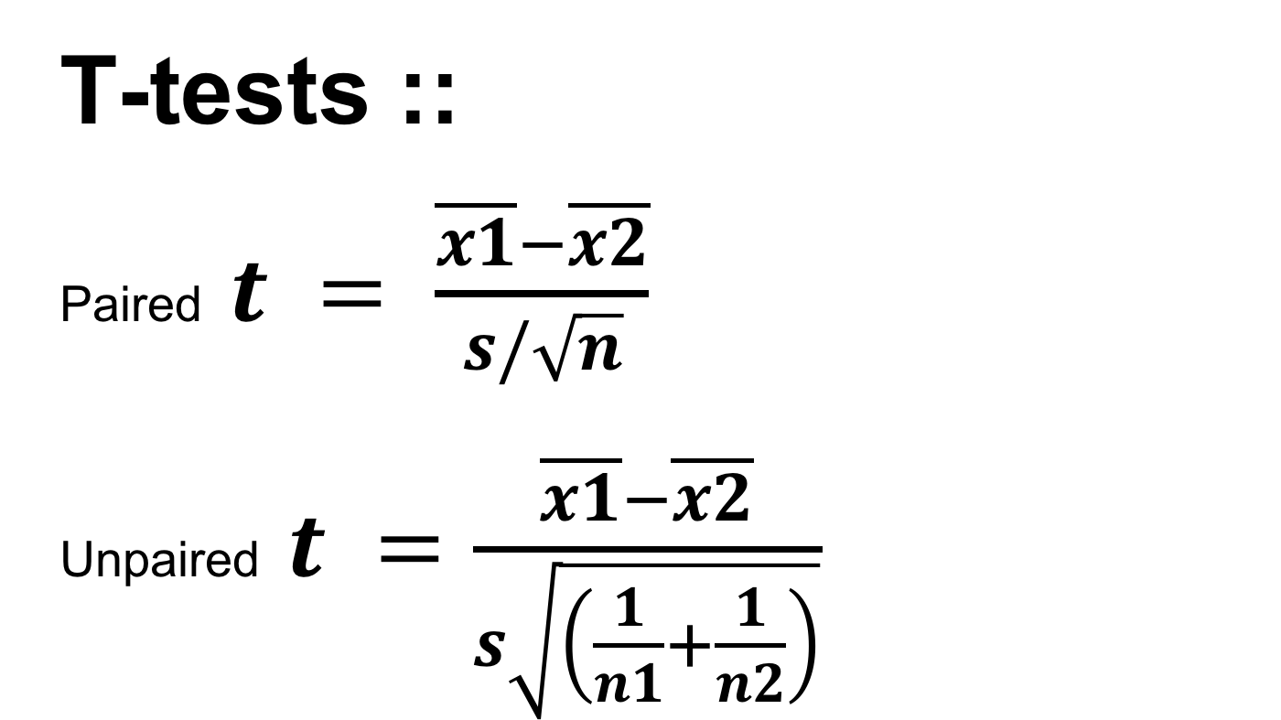
T-tests ::
Paired $t = \frac{\overline{x1}−\overline{x2}}{s/\sqrt{n}}$
Unpaired $t =\frac{\overline{x1}−\overline{x2}}{s\sqrt{\left(\frac{1}{n1}+\frac{1}{n2}\right)}}$

Slide 15
paired t-test

Slide 16
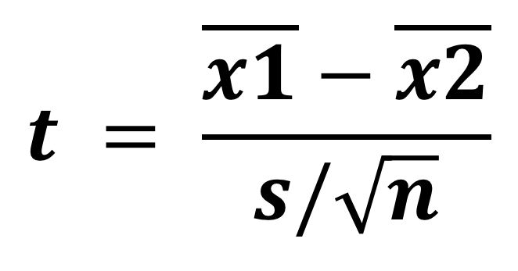
different between group means
(to maximize)
$$t = \frac{\overline{x1}−\overline{x2}}{s/\sqrt{n}}$$
standard deviation
of the differences
(to minimize)

Slide 17
different between group means
(to maximize)
$$t = \frac{\overline{x1}−\overline{x2}}{s/\sqrt{n}}$$
standard error of the mean
(to minimize)
but why do we need to divide by $\sqrt{n}$ (n = sample size)?

Slide 18
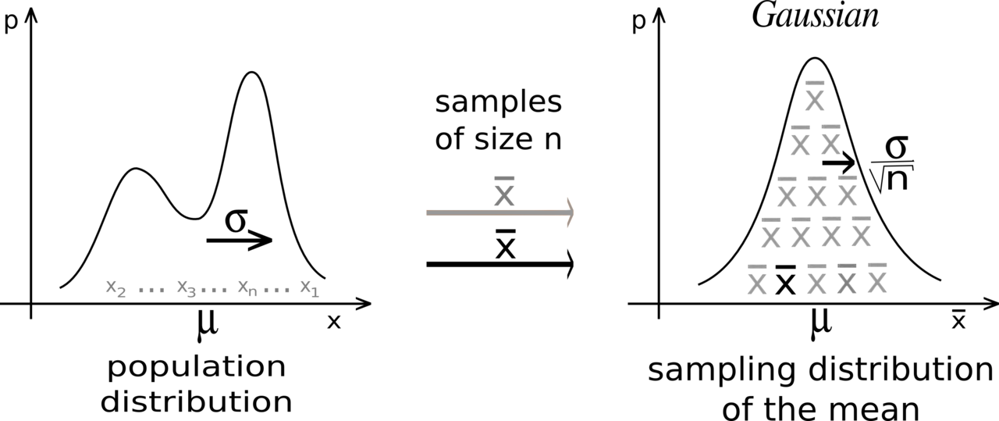
this comes from the central limit theorem you have seen before with Conor

Slide 19
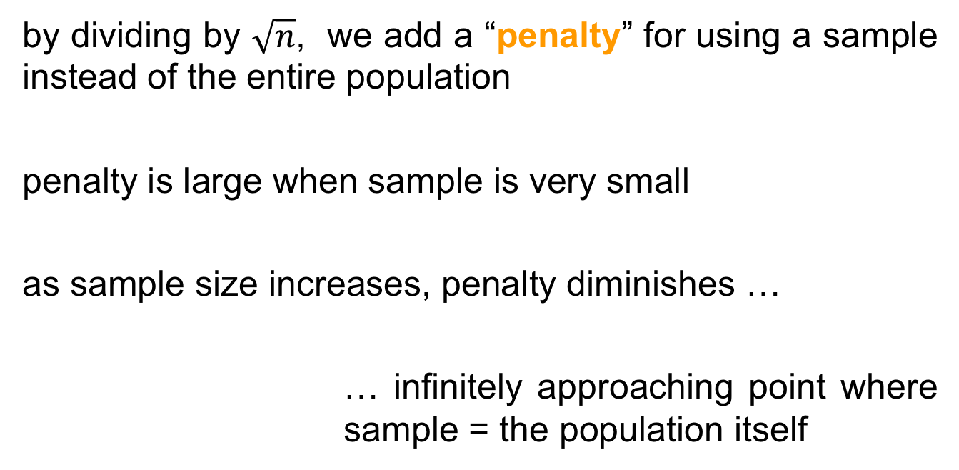
by dividing by $\sqrt{n}$, we add a “penalty” for using a sample instead of the entire population
penalty is large when sample is very small
as sample size increases, penalty diminishes …
… infinitely approaching point where sample = the population itself

Slide 20
$$t = \frac{\overline{x1}−\overline{x2}}{s/\sqrt{n}}$$
we get a t-value
(to maximize)

Slide 21
both signal and noise are in the units of your data
If signal = 6 and noise = 2, your t-value = 3, so the difference is 3 times the size of the standard error
If signal = 6 and noise = 6, your t-value = 1, the signal is at the same scale as the noise
t-values = how distinguishable signal from noise

Slide 22
how do we know our t-value is any good, and how does this related to p-value?
this is where t-distributions come in

Slide 23
studyX
study1
t=0.9
t=1.5
population
study2
…
t=1.4
study4
study3
t=1.1
t=0.9
now let’s take all these possible values and …
Notes:
When you perform a t-test for a single study, you obtain a single t-value. However, if we drew multiple random samples of the same size from the same population and performed the same t-test, we would obtain many t-values and we could plot a distribution of all of them

Slide 24
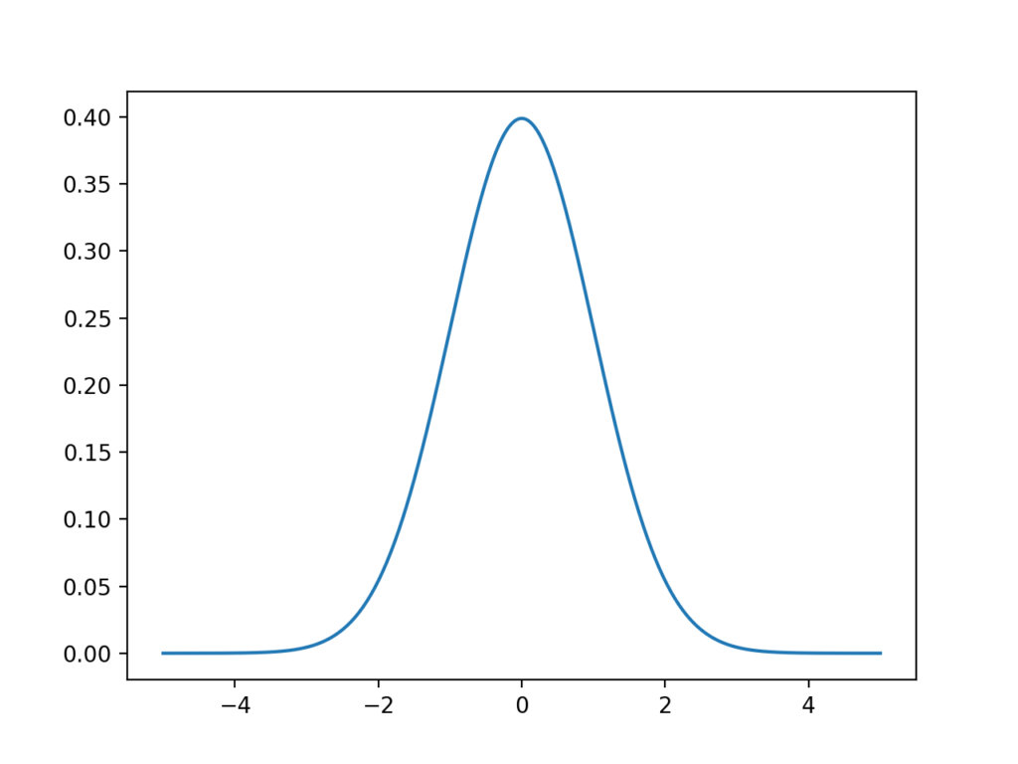
t-value
… plot a distribution of them
this type of distribution is a sampling distribution

Slide 25
fortunately, the properties of t-distributions are well understood in statistics, so we can plot them without having to collect many samples!
a specific t-distribution is defined by its degrees of freedom (DF), a value closely related to sample size (here n-1)
different t-distributions exist for every sample size

Slide 26
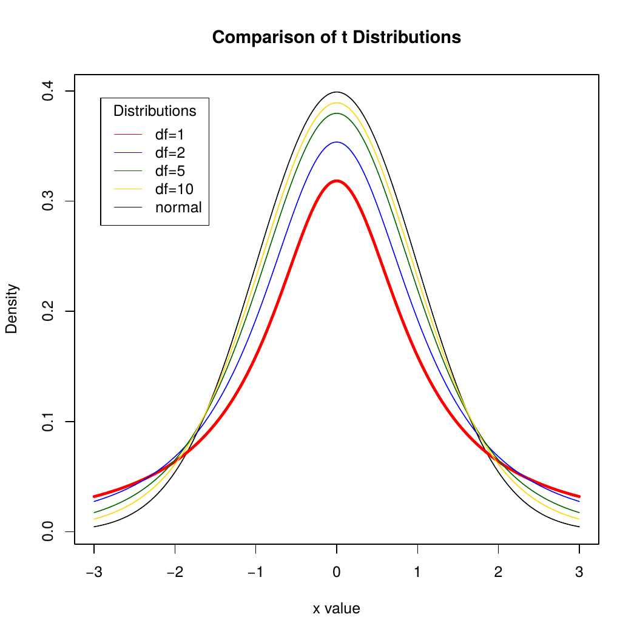
t-value

Slide 27
t-distributions assume that you draw repeated random samples from a population where the null hypothesis is true. You place the t-value from your study in the t-distribution to determine how consistent your results are with the null hypothesis.

Slide 28
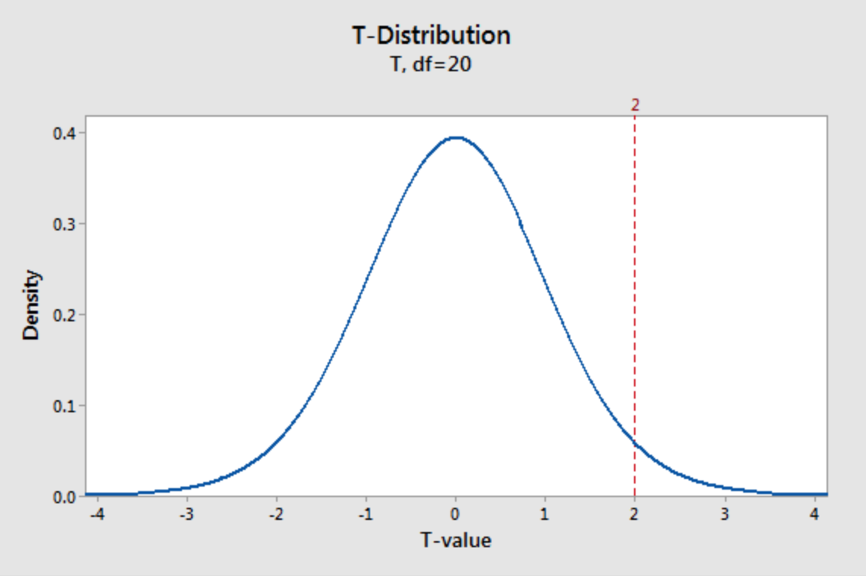
imagine a t-value of 2
seems unusual but how exactly unusual?
e.g. here a t-distribution (DF =20 which means a sample size of 21). It plots the probability density function (PDF), which describes the likelihood of each t-value.

Slide 29
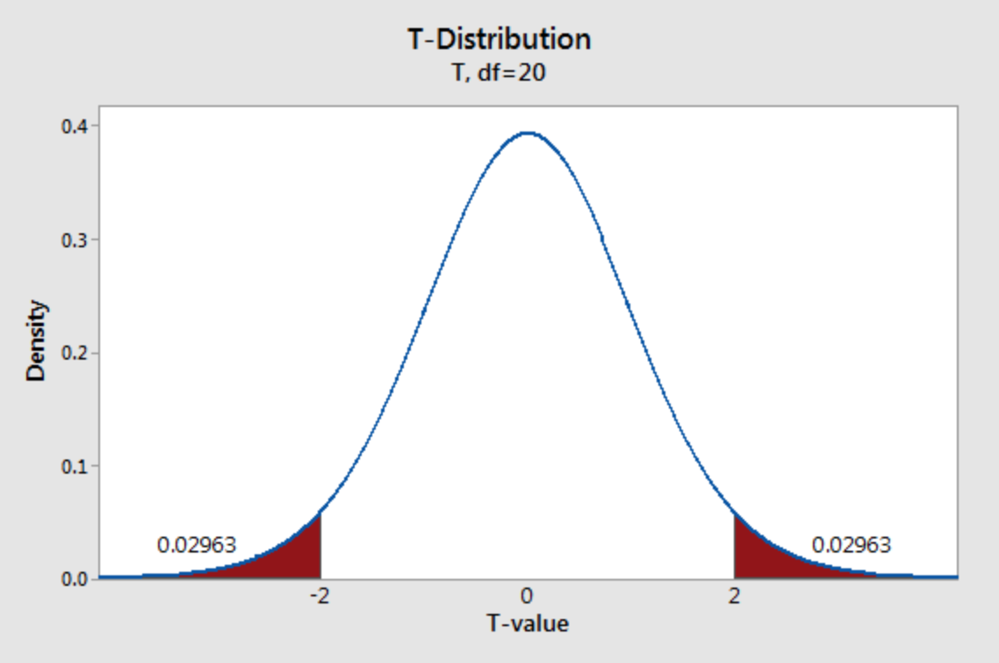
shade the area of the curve with t-values >2 and <-2
each regions has a probability of 0.02963, which sums to a total probability of 0.05926
… this is our pvalue!

Slide 30
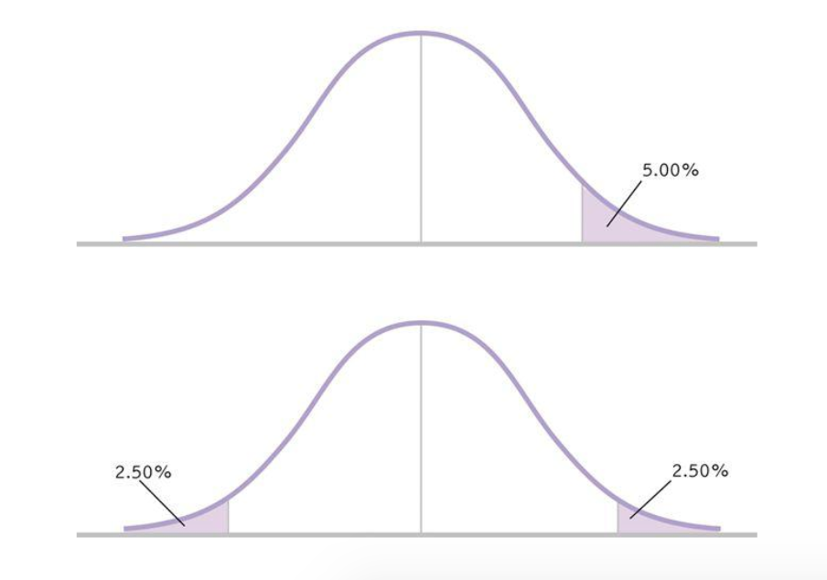
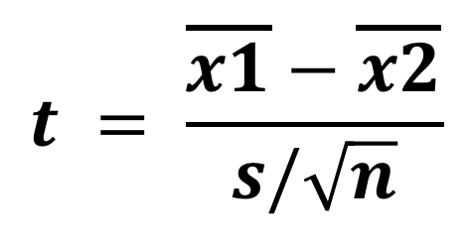
one-tail
$$t = \frac{\overline{x1}−\overline{x2}}{s/\sqrt{n}}$$
two-tails
it also does explain one-tail vs. two tails t-tests: one-tail only case about t=2 (not -2 or oppositely), so multiply pvalue by two.

Slide 31
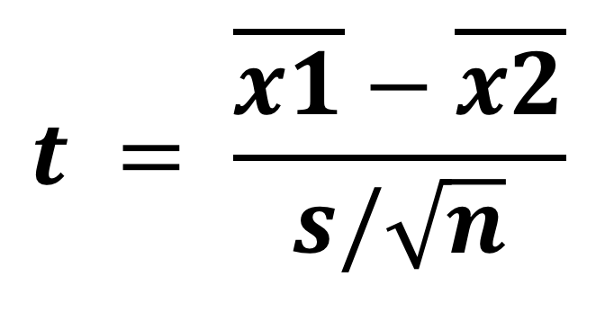
at this point you understand more the three reasons of a low p_value (or t_value)
1. difference not large enough
(what you are searching for, your signal is weak)
$$t = \frac{\overline{x1}−\overline{x2}}{s/\sqrt{n}}$$
2. too much noise
(could your experimental design introduce noise? Check it)
3. not enough data
(run more participants, gather more trials)

Slide 32
how much data is enough?

Slide 33
the larger the sample size, the more t-distributions become a z-distribution (at around n=30), the less the area under the curve to reach a low pvalue.

Slide 34
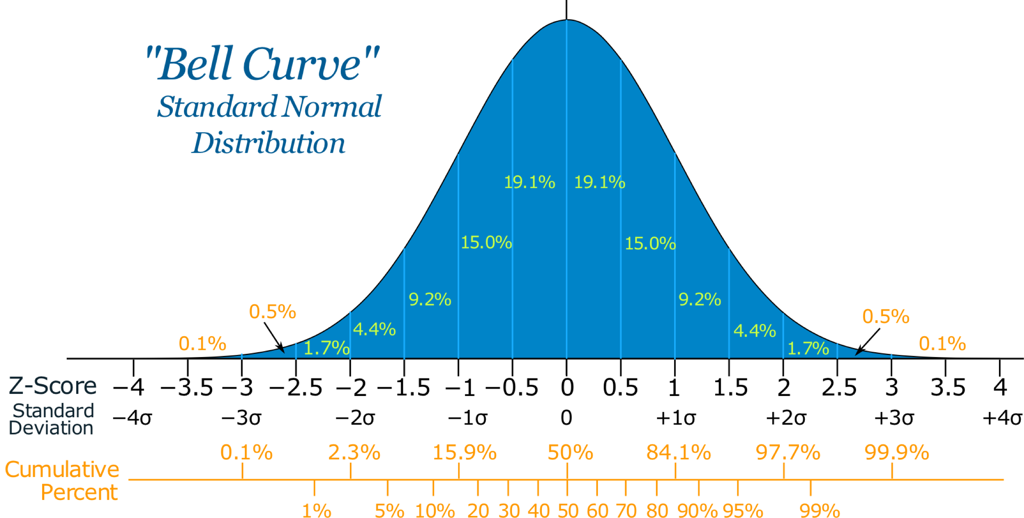
mean that more sample = back to using a Z-score (i.e. number of standard deviations from the mean on normal distribution)

Slide 35
so why using a t-test then?
well there are cases when we want to use less sample to speed up the evaluation
this was the case of William Sealy Gosset …

Slide 36
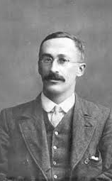

Employee of Guiness, Gosset developed a small sample method to select the best yielding varieties of barley.
Biometricians like Pearson typically had hundreds of observations.
Guinness allowed him to publish his method under the name “Student” to prevent disclosure of confidential information.
Where do t-distrubitions came from?
https://www.youtube.com/watch?v=NvUDvmrd6fo&feature=youtu.be

Slide 37
now it does not mean that 2 sample is enough … a rule of thumb for a simple within experiment is 12-16 participants for example (and twice more for between experiment).
… we will actually look at how to know if you sample size is good in the last week
… this is our pvalue!

Slide 38
unpaired t-test

Slide 39
T-tests ::
Paired $t = \frac{\overline{x1}−\overline{x2}}{s/\sqrt{n}}$
Unpaired $t =\frac{\overline{x1}−\overline{x2}}{s\sqrt{\left(\frac{1}{n1}+\frac{1}{n2}\right)}}$
similar than paired t-test except this

Slide 40
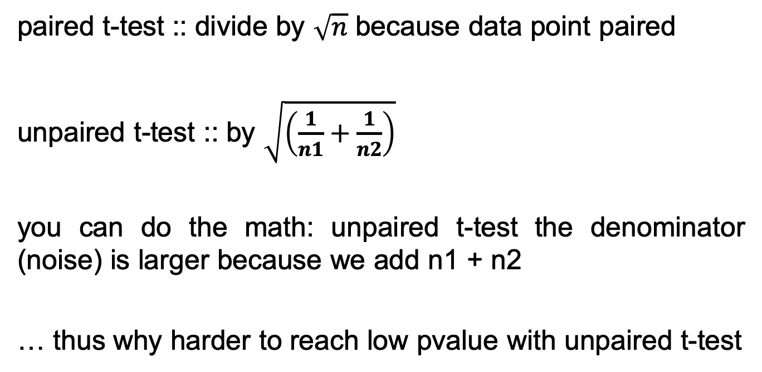
paired t-test :: divide by $\sqrt{n}$ because data point paired
unpaired t-test :: by $\sqrt{\left(\frac{1}{n1}+\frac{1}{n2}\right)}$
you can do the math: unpaired t-test the denominator (noise) is larger because we add n1 + n2
… thus why harder to reach low pvalue with unpaired t-test

Slide 41
anovas

Slide 42
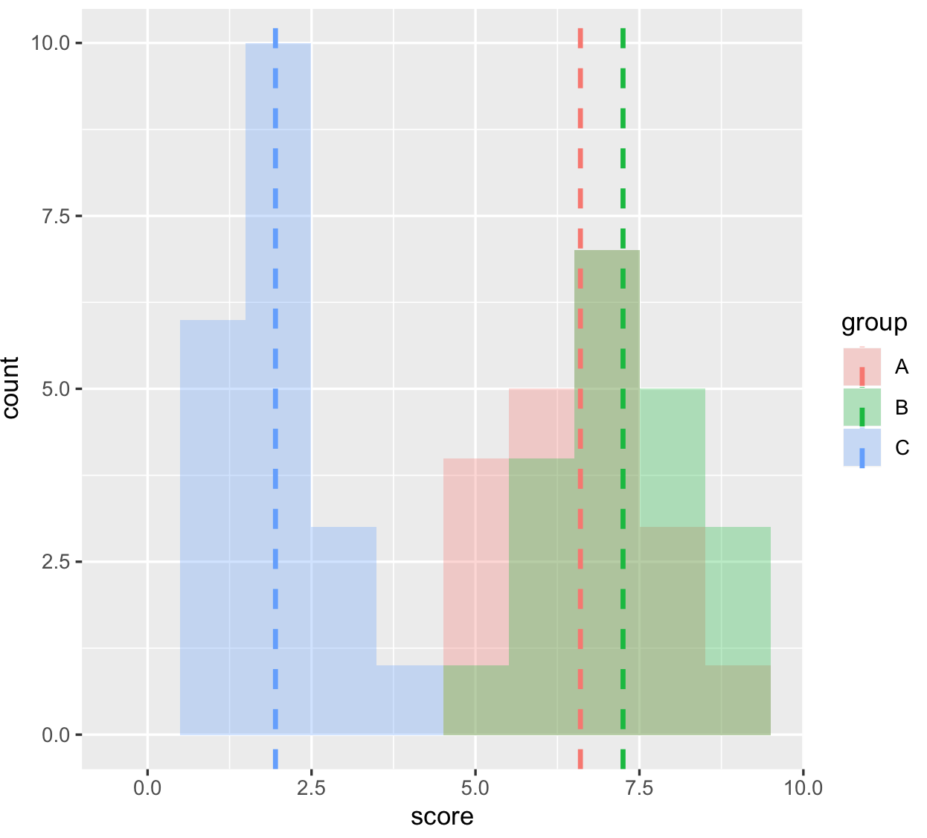

Slide 43
count
memorization score
(let’s assume again these are normally distributed)

Slide 44
any statistical tests ::
signal
noise

Slide 45
signal
ANOVA ::
noise
difference between group means
variability of groups

Slide 46
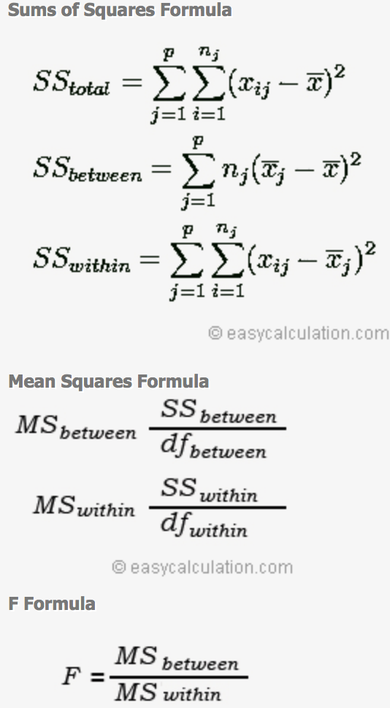
ANOVA ::

Slide 47
don’t be afraid by these equations, these are just simple math
if you like that kind of calculation you can even do it by hand …

Slide 48
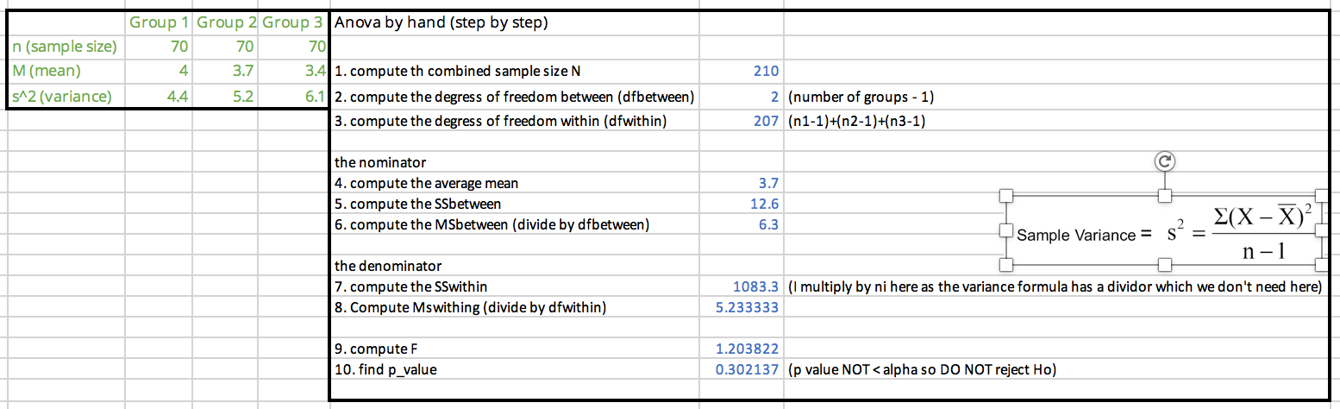
(excel file in the git hub repository)

Slide 49
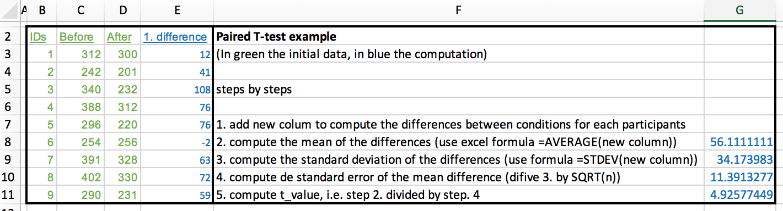
(excel file in the git hub repository)

Slide 51
ANOVA ::

Slide 52
how do we know if the Fvalue is anygood?
… this is where F-distributions come in

Slide 53
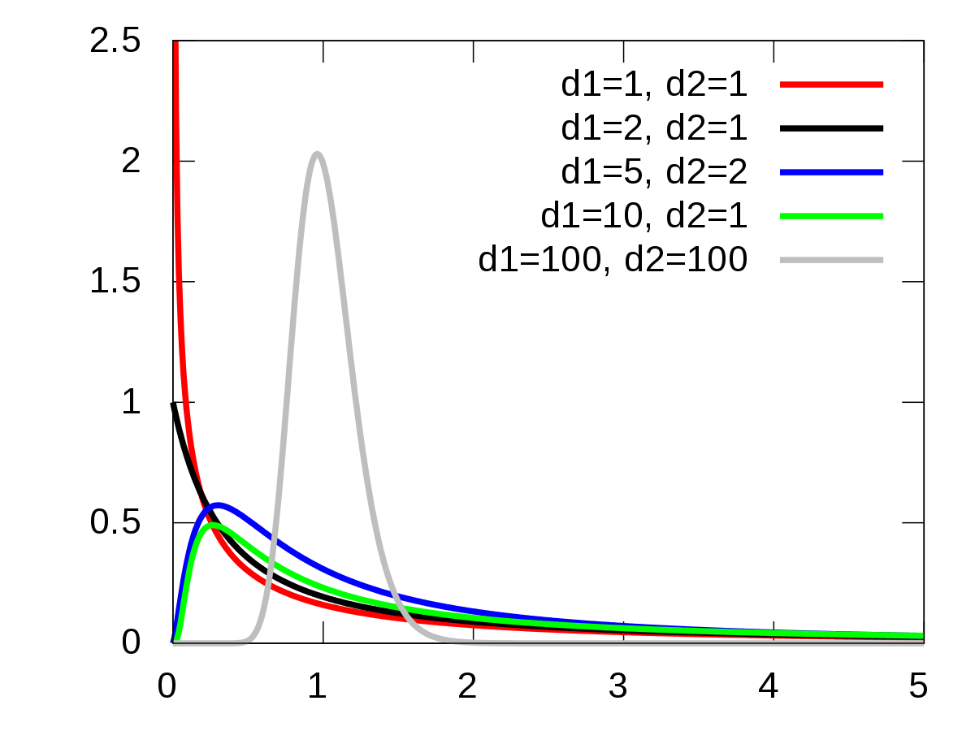
they take two degrees of freedom rather than just one like with t-distributions

Slide 54
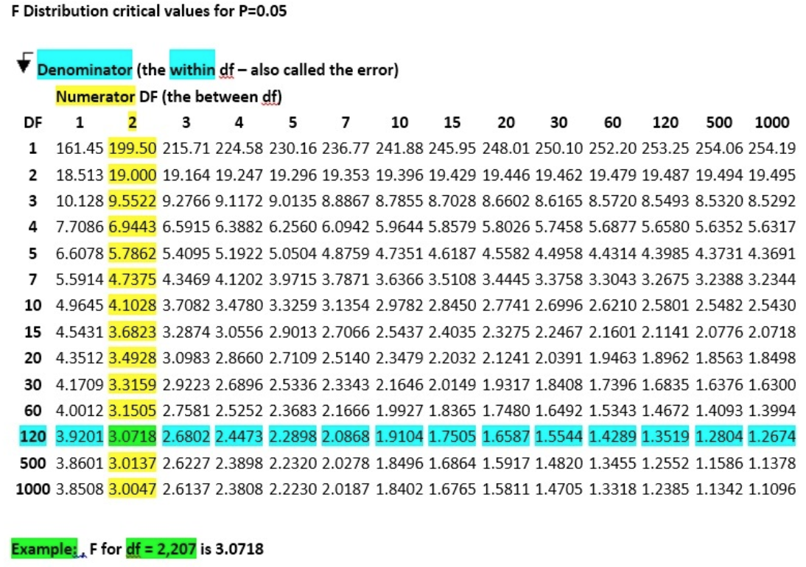
also in form of table (here for the dfwithin and dfbetween of our excel example)

Slide 55
R
# first we run the one-way anova
library(ez)
ezANOVA(dat,id,between=group,dv=score)
Effect DFn DFd F p p<.05 ges
1 group 2 57 154.8886 9.056612e-24 * 0.8445923
# second, run the pairwise comparison
pairwise.t.test(dat$score,dat$group, paired=FALSE, p.adjust.method="bonferroni")
A B
B 0.16 -
C <2e-16 <2e-16
ok something is going
to be interesting here
here are significant differences
and we don’t need to do the Bonferroni correction (already included)
this was from last week, R gives us all this numbers
Notes:
head(cars) # cars is a table that already comes with R and contain 50 observations of speed and distance in two rows
scatter.smooth(x=cars$speed, y=cars$dist, main="Dist ~ Speed") # scatterplot
linearMod <- lm(dist ~ speed, data=cars) # build linear regression model on full data
summary(linearMod) # summary(linearMod)$r.squared
abline(linearMod, col="blue")

Slide 56
degrees of freedom

Slide 57
degrees of freedom::
the number of values in the final calculation of a statistic that are free to vary
a complex notion but here is the intuition …

Slide 58
you have 7 hats, you want to wear one different every day for a week
Monday: 7 choices
Tuesday: 6 choices
Wednesday: 5 choices
Thursday: 4 choices
Friday: 3 choices
Saturday: 2 choices
Sunday: NO choice
degrees of freedom is 7-1

Slide 59
if we have 7 observations and the mean of these observation (that you need to do t-test or Anova) your degree of freedom is 7-1
because if you know 6 observations you automatically know the 7th one (thanks to the mean)

Slide 60
remember the lecture on regression?

Slide 61
1
standard error of the estimate
T time
(ms)
Fitts! T = 2.3 + 1.1 ID
ˆ
∑ (estimated y – actual y)²
(sample size-2)
ID index of difficulty
also called degree of freedom

Slide 62
a simple (approximate) way to understand this is that we have two variables, the slope and the intercept of the regression line
that give us extra information, thus the minus 2

Slide 63
statistic tests on multiple ID variables

Slide 64
until now, we did statistical test on one independent variable (with multiple conditions or groups) and one dependant variable
e.g. effect of chocolate, baseline, punishment (IV) on memorization score (DV)
now it is possible to do tests for multiple IVs and multiple DVs

Slide 65
however doing so decrease the power of your experiment (because you run more tests)
so it only works with powerful tests based on ANOVA (i.e. continuous variable and assumption of normality and homogeneity assumed)
e.g. two-ways ANOVA, MANOVA, ANVOVA

Slide 66
discrete IV
continuous DV
one-way ANOVA::
compare the effect of one discrete independent variables, having 2 or more levels on one dependant variable
e.g. effect of alcohol consumption (none, 2-pints, 4-pints) on attractiveness ratings

Slide 67
discrete IV
continuous DV
discrete IV
two-way ANOVA::
compare the effect of two discrete independent variables, each of them having 2 or more levels on one dependant variable
e.g. effect of gender (female, male) and alcohol consumption (none, 2-pints, 4-pints) on attractiveness ratings

Slide 68
continuous DV
discrete IV
continuous DV
one-way MANOVA::
(multivariate analysis of variance) compare the effect of one independent variable, having 2 or more levels on two dependant variables
e.g. effect of different memorization enhancing drugs (placebo, drug A, drug B) on memorization skills and emotional ratings (to find the sweet spot for a drug that enhance skills without depressing people!)

Slide 69
discrete IV
continuous DV
continuous covariate
one-way ANCOVA::
(analysis of covariance) compare the effect of one independent variable, having 2 or more levels and one continuous covariate on one dependant variable
e.g. effect of phone sizes (iphone 4, iphone 5, iphone 6, iphone 7) on the amplitude of phone movements made when texting given the measure of the participants hand width (covariate)

Slide 70
discrete IV
continuous DV
continuous covariate
continuous DV
one-way MANCOVA::
(multivariate analysis of covariance) compare the effect of one independent variable, having 2 or more levels and one continuous covariate on two dependant variable
… you can even two a two-way MANCOVA (but your experience might not have much statistical power because there are too many tests to perform)

Slide 71
although these tests exist, my advice is to keep the experimental design as simple as possible as you can, analysis will be easier and more powerful
… will look at power with
guest lecturer: Luluah Al-Barrack

Slide 72
summary

Slide 73
take away
Explain the general equation of a statistical test (signal/noise)
Explain how a t-test is computed and be able to do it by hand
Explain the 3 reasons why a t-value can be low (signal too low, noise too high, small sample)
Explain how an Anova is computed, and be able to do it by hand
Explain what are t-distributions and f-distributions

Slide 74



try this with a friend during reading weeks
https://tinyurl.com/statsBristol
tea
milk
water
don’t tell them how you made the cup
tea
water
milk

Slide 75
end

Slide 76
extra

Slide 77
two ways ANOVA practically

Slide 78
R
# two-ways anova in R (I added a gender column in our chocolate vs. reward vs. punishment file)
library(ez)
dat = read.csv("HCI2018resultsTwoWays.csv", header = TRUE)
ezANOVA(dat,id,between=.(group,gender),dv=score)
Effect DFn DFd F p p<.05 ges
1 group 2 54 72.7776 4.709005e-16 * 0.72939818
2 gender 1 54 1.4112 2.400561e-01 0.02546778
3 group:gender 2 54 0.8064 4.517654e-01 0.02900052
# note here our two IV are between but we could have them both within or a combination of within and between we would write: ezANOVA(dat,id,within=group,between=gender,dv=score)
Like with one way with have the effect for each IV
As well as the interaction between both
Notes:
head(cars) # cars is a table that already comes with R and contain 50 observations of speed and distance in two rows
scatter.smooth(x=cars$speed, y=cars$dist, main="Dist ~ Speed") # scatterplot
linearMod <- lm(dist ~ speed, data=cars) # build linear regression model on full data
summary(linearMod) # summary(linearMod)$r.squared
abline(linearMod, col="blue")

Slide 79
we can write (only the significant one)
A two-way ANOVA showed a significant effect on IV1 (Fdf = F_value, p<0.05), on IV2 (Fdf = F_value, p<0.05) and on the interaction IV1 x IV2 (Fdf = F_value, p<0.05)
and then you can do your post-hoc comparison tests (although there are more to do!) and conclude

